Slide 1
Introduction vision
part I

Slide 2
Content
Convolution
Theory
1D
signal -> frequency
2D
Applications
canny edge / optical flow/ shift / cnn / template matching*
...

Slide 3
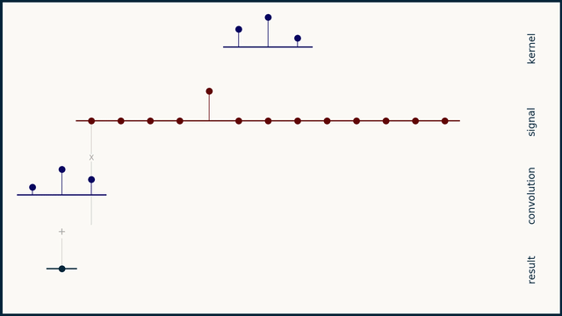
Convolution 1D
https://e2eml.school/convolution_one_d.html

Slide 4
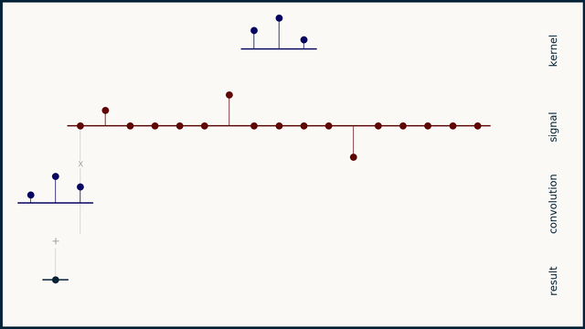
Convolution 1D
https://e2eml.school/convolution_one_d.html

Slide 5
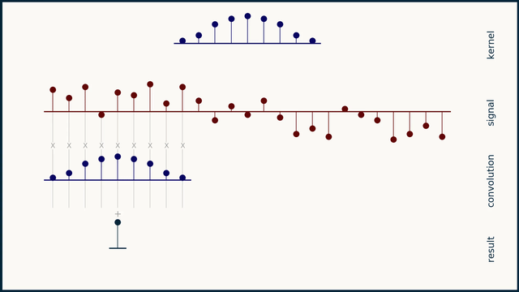
Convolution 1D
https://e2eml.school/convolution_one_d.html

Slide 6
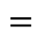
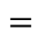




-1 | 0 | 1
$$⊗$$
255 | 255 | 255 | 255 | 255 | 0 | 0 | 0 | 0 | 0 | 255
$$=$$
1/3 | 1/3 | 1/3
$$⊗$$
255 | 255 | 255 | 255 | 255 | 0 | 0 | 0 | 0 | 0 | 255
$$=$$
1/4 | 1/2 | 1/4
$$⊗$$
255 | 255 | 255 | 255 | 255 | 0 | 0 | 0 | 0 | 0 | 255
$$=$$

Slide 7
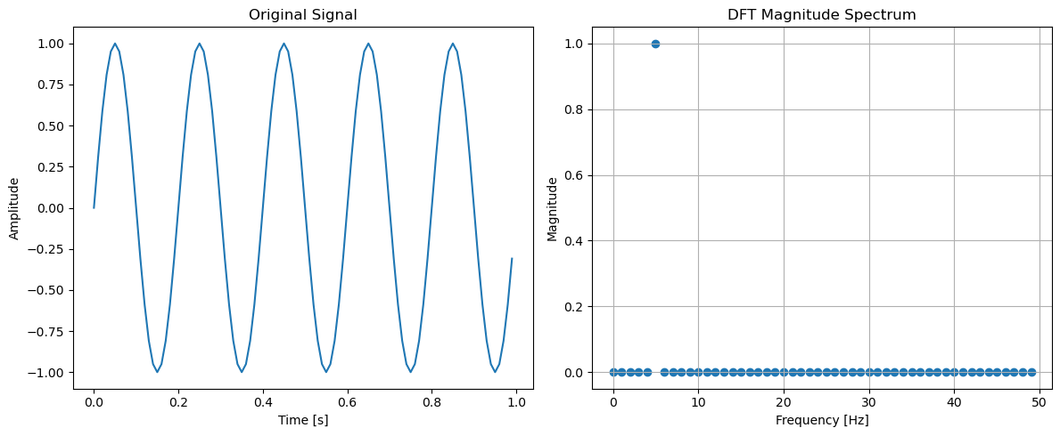
Signal -> Frequency

Slide 8
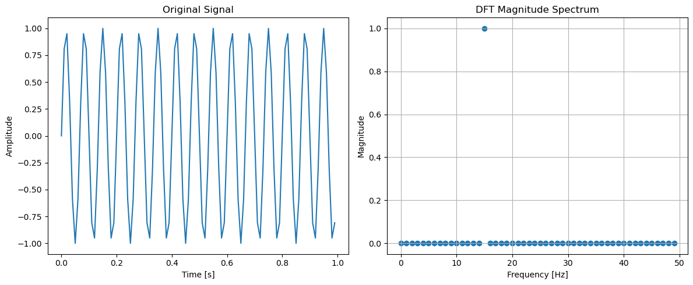
Signal -> Frequency

Slide 9
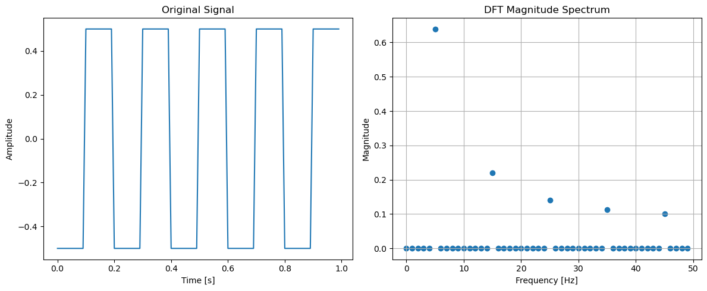
Signal -> Frequency

Slide 10
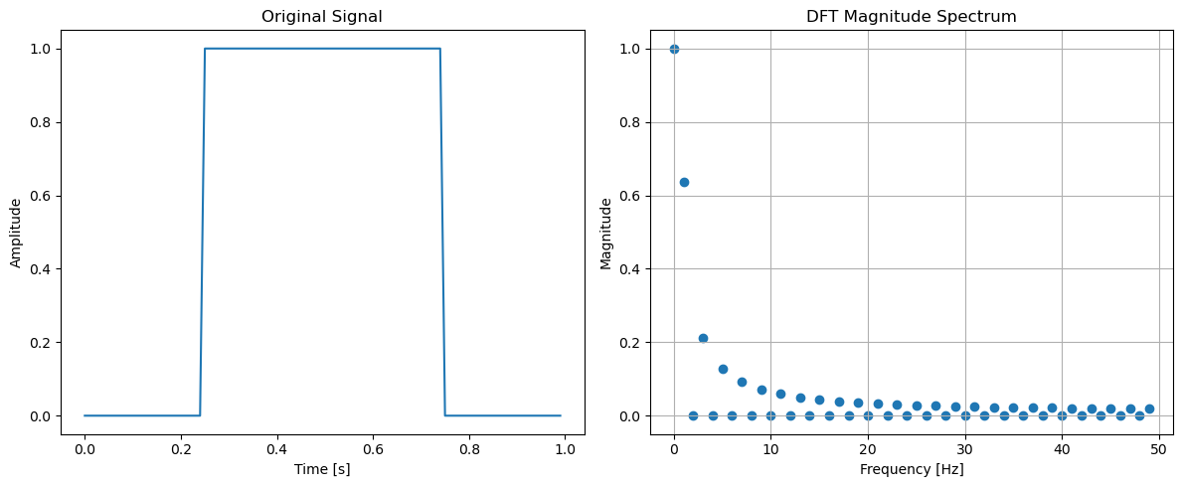
Signal -> Frequency

Slide 11
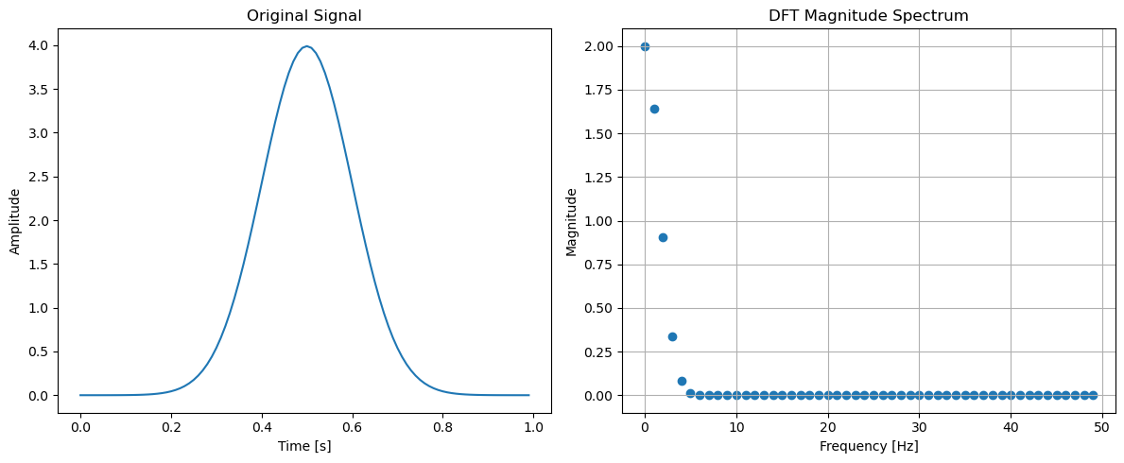
Signal -> Frequency

Slide 12
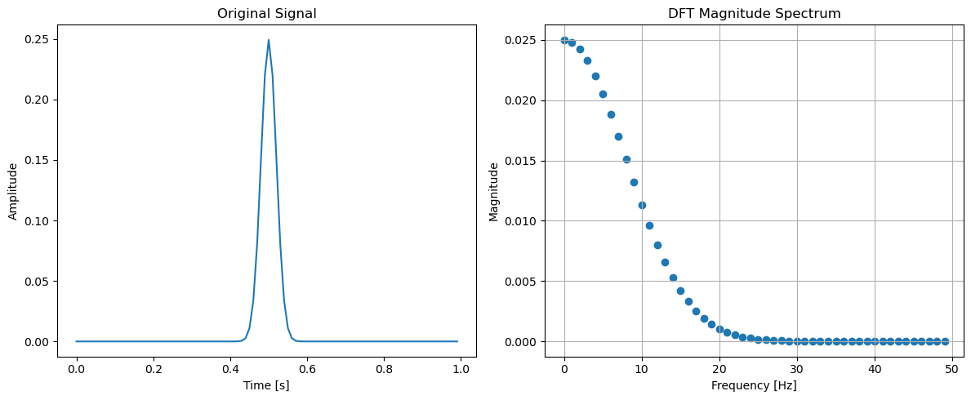
Signal -> Frequency

Slide 13
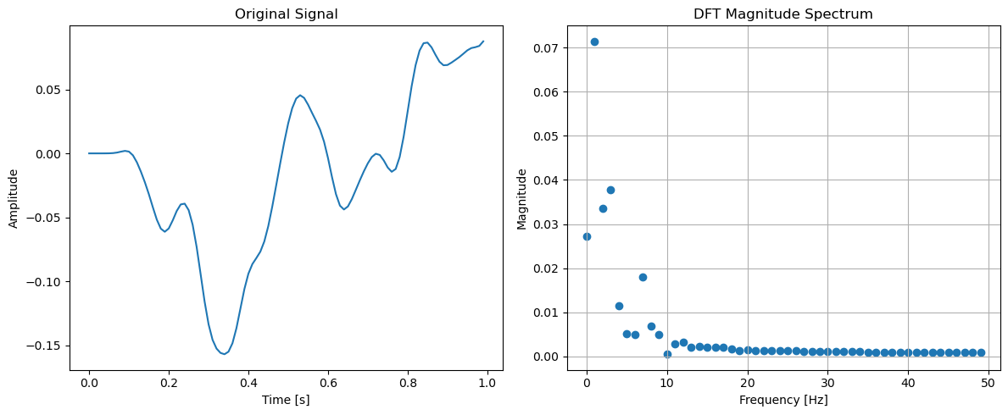
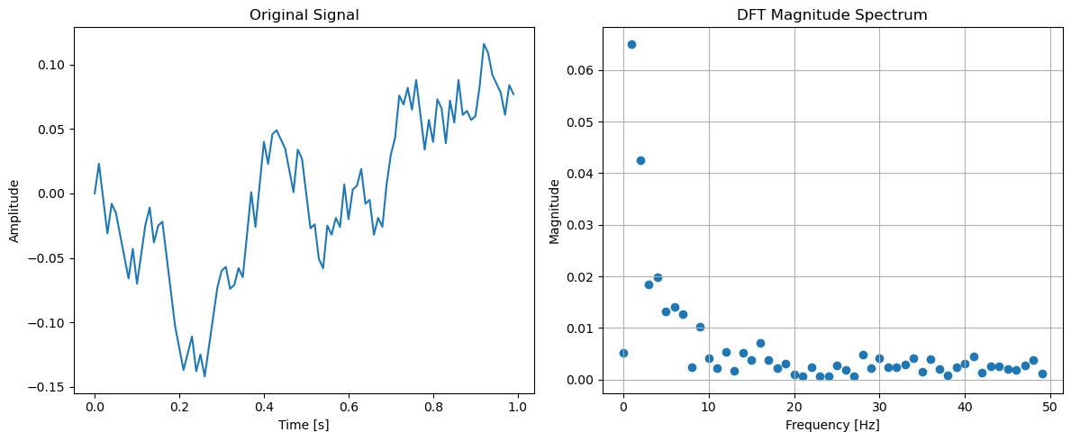
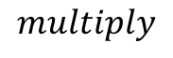


Back to convolution
$$⊗$$
$$multiply$$
$$=$$

Slide 14
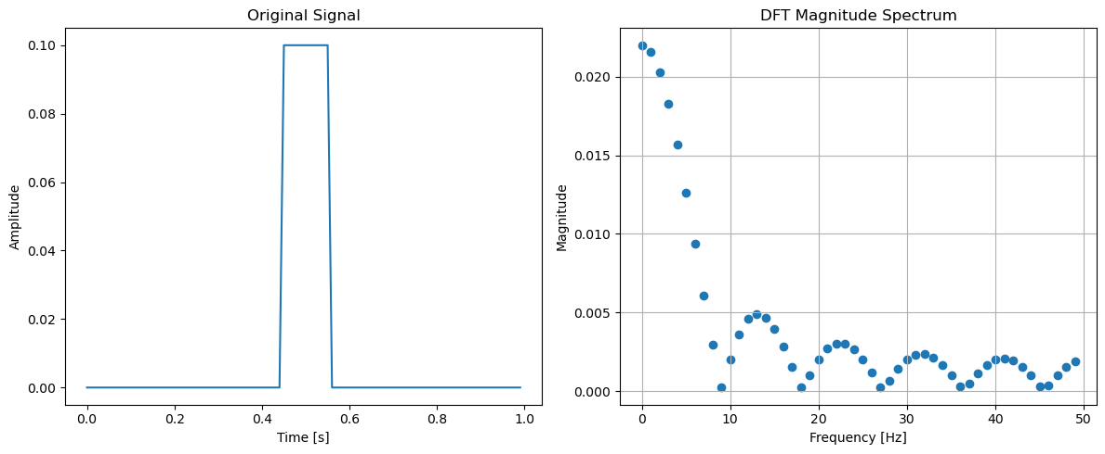
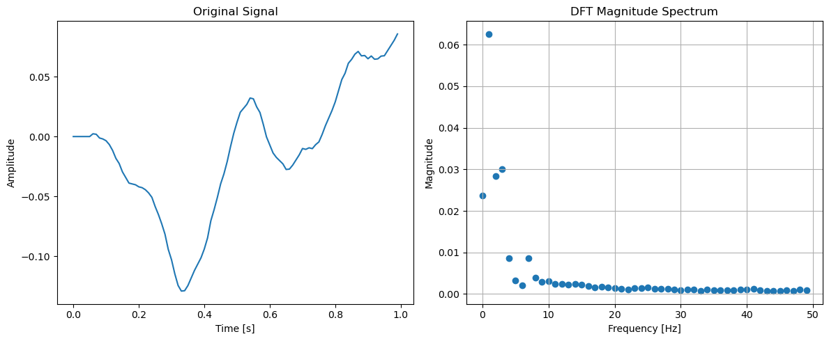
Back to convolution
$$⊗$$
$$=$$
Gaussian blur....

Slide 15
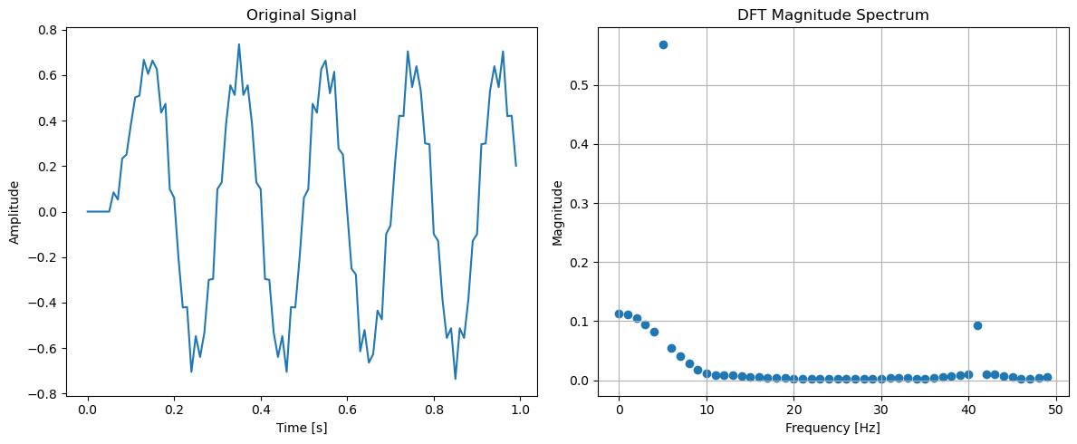
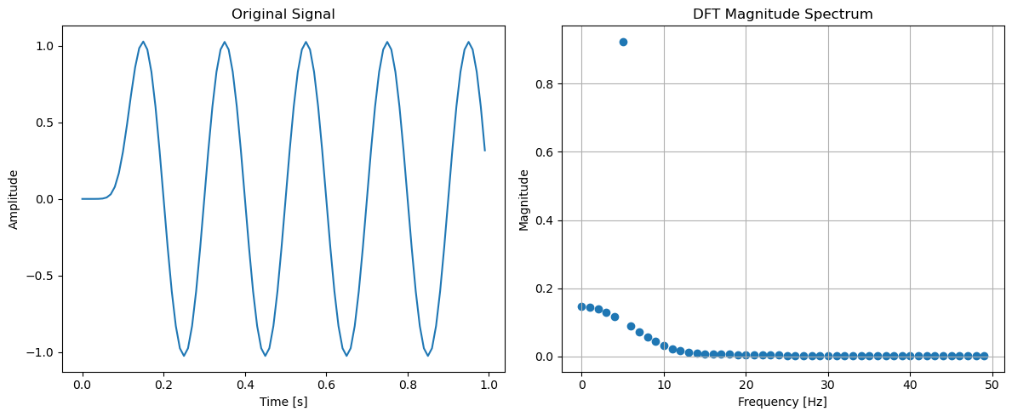
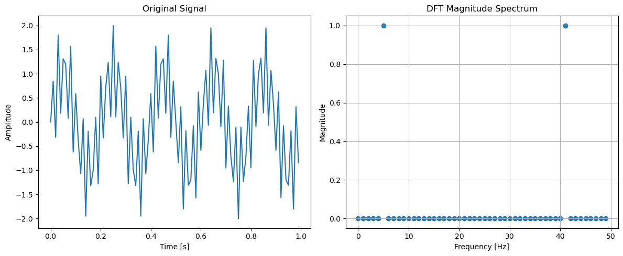

Slide 16
Back to 2D!!!

Slide 17
-1 | 0 | 1
$$⊗$$
255 | 255 | 255 | 255 | 255 | 0 | 0 | 0 | 0 | 0 | 255
$$=$$
1/3 | 1/3 | 1/3
$$⊗$$
255 | 255 | 255 | 255 | 255 | 0 | 0 | 0 | 0 | 0 | 255
$$=$$
1/4 | 1/2 | 1/4
$$⊗$$
255 | 255 | 255 | 255 | 255 | 0 | 0 | 0 | 0 | 0 | 255
$$=$$

Slide 18


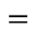

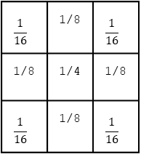
255 | 255 | 255 | 0 | 0 | 0 | 255 | 255
255 | 255 | 255 | 0 | 0 | 0 | 255 | 255
255 | 255 | 255 | 0 | 0 | 0 | 255 | 255
255 | 255 | 255 | 0 | 0 | 0 | 255 | 255
255 | 255 | 255 | 0 | 0 | 0 | 255 | 255
255 | 255 | 255 | 0 | 0 | 0 | 255 | 255
-1 | 0 | 1
-2 | 0 | 2
-1 | 0 | 1
$$⊗$$
$$=$$
255 | 255 | 255 | 0 | 0 | 0 | 255 | 255
255 | 255 | 255 | 0 | 0 | 0 | 255 | 255
255 | 255 | 255 | 0 | 0 | 0 | 255 | 255
255 | 255 | 255 | 0 | 0 | 0 | 255 | 255
255 | 255 | 255 | 0 | 0 | 0 | 255 | 255
255 | 255 | 255 | 0 | 0 | 0 | 255 | 255
$$\frac{1}{16}$$ | 1/8 | $$\frac{1}{16}$$
1/8 | 1/4 | 1/8
$$\frac{1}{16}$$ | 1/8 | $$\frac{1}{16}$$
$$⊗$$
$$=$$

Slide 19
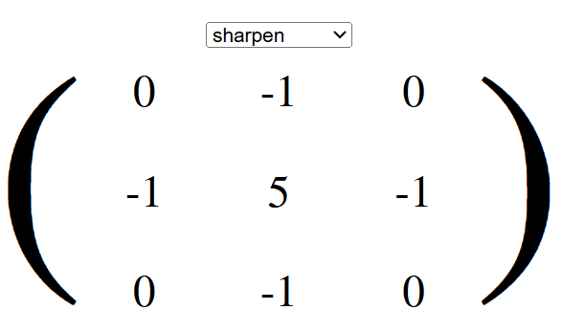
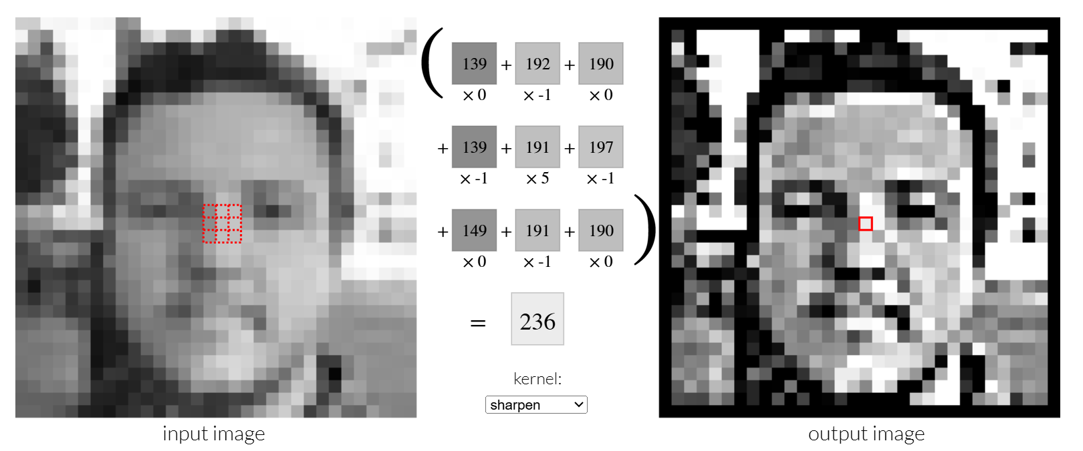
https://setosa.io/ev/image-kernels/

Slide 20
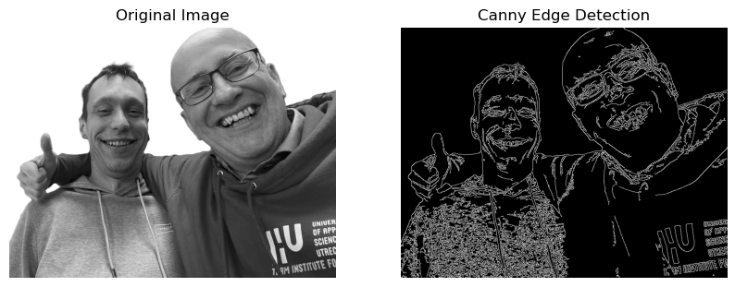
Applications – Canny Edge

Slide 21
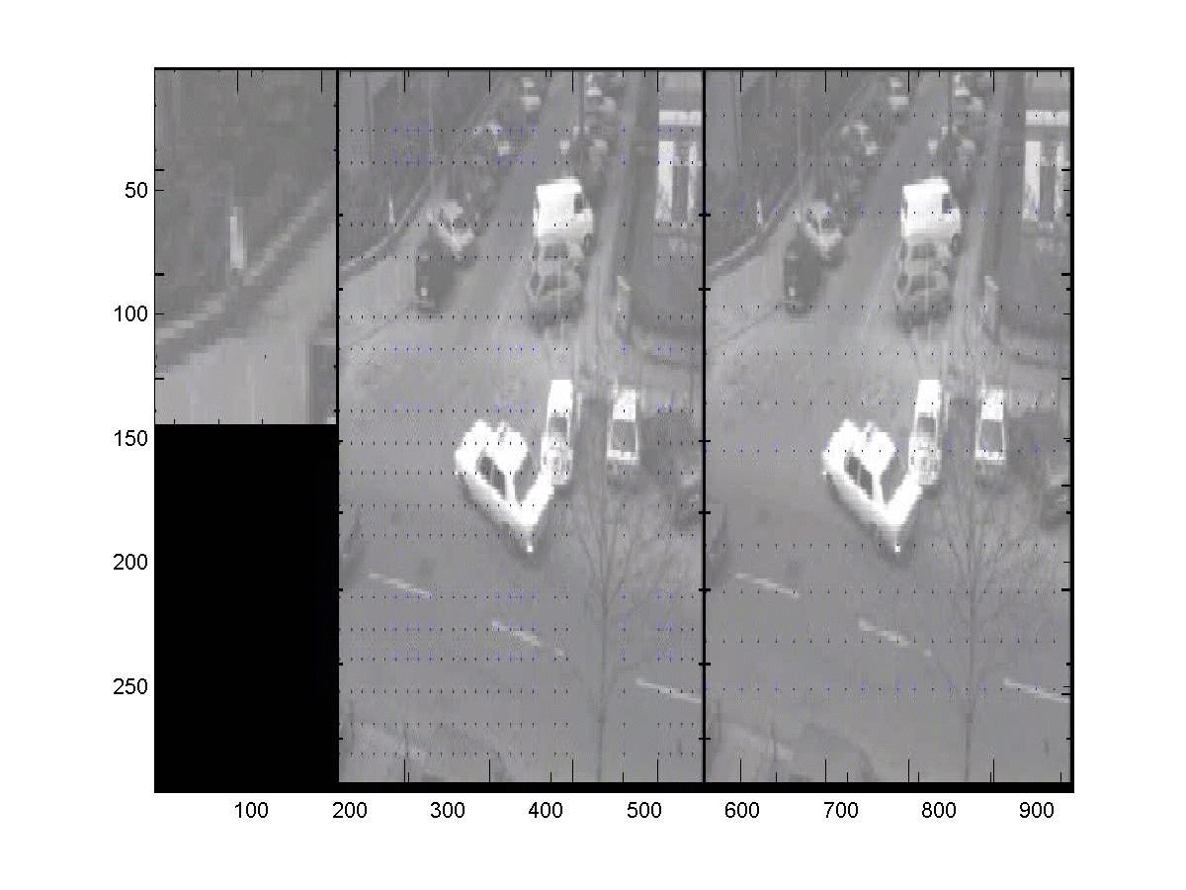
Applications – Optical Flow

Slide 22
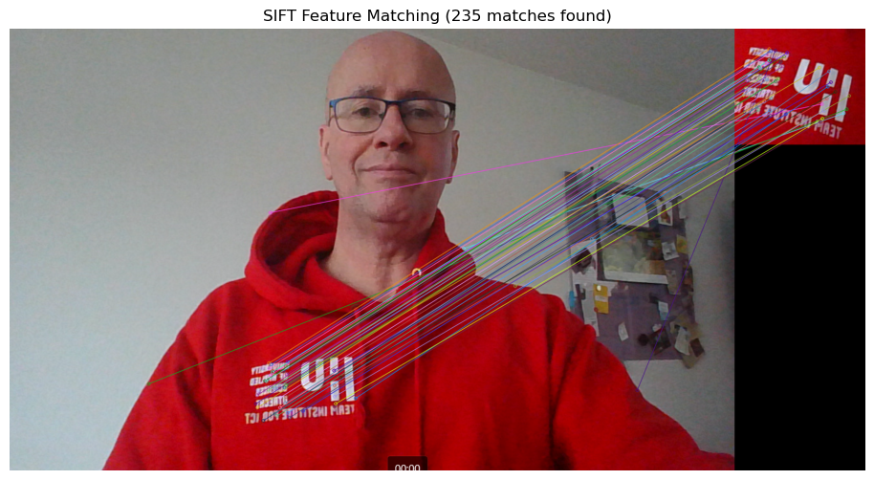
Applications - SIFT
keypoints

Slide 23
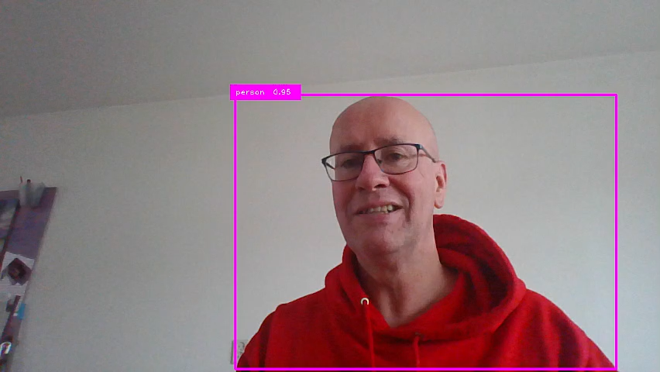
Applications – CNN (Yolo)

Slide 24
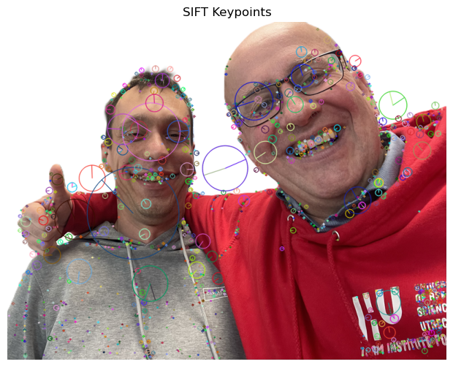
SIFT & Optical Flow -> Op zoek naar patches die matchen

Slide 25
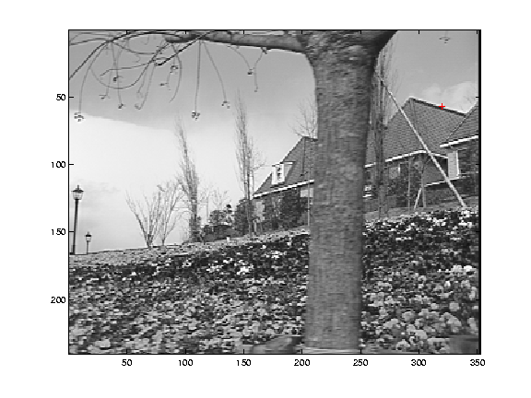
Low-texture region

Slide 26
Edge

Slide 27
High-texture region

Slide 28
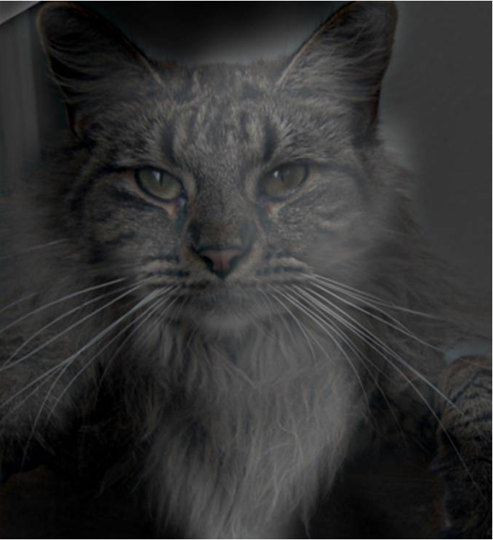
Hybrid Image

Slide 29
Hybrid Image

Slide 30
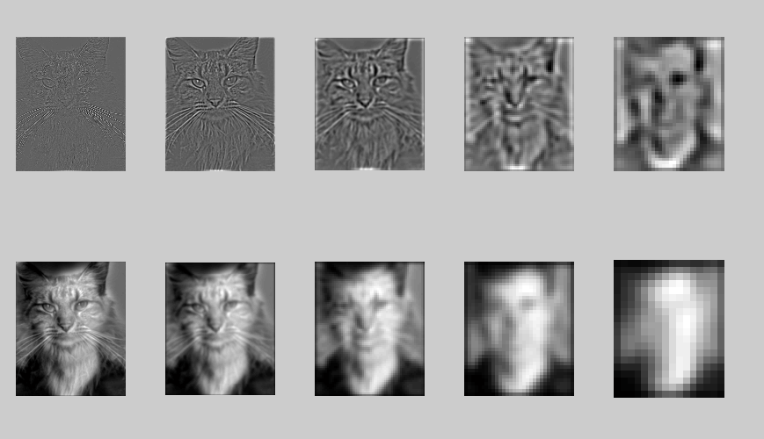
High frequency → Low frequency

Slide 31
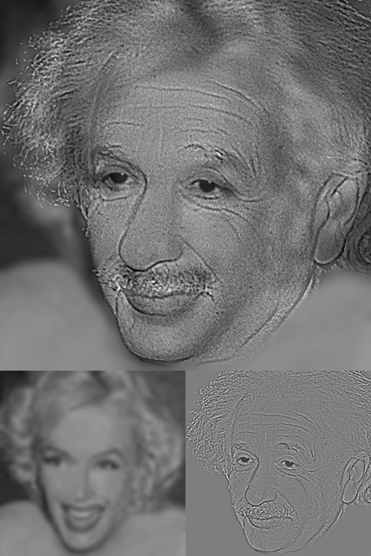
Hybrid Image

Slide 32
Hybrid Image

Slide 33
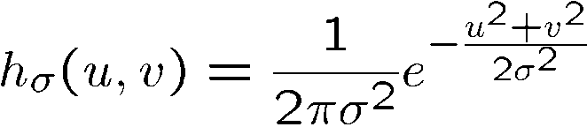
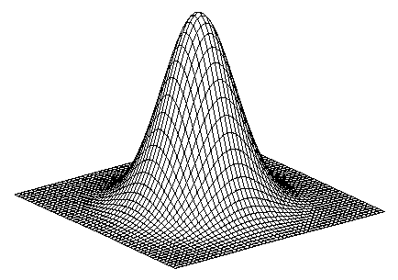
Gaussian
Notes:
How many 2nd derivative filters are there? There are four 2nd partial derivative filters.
In practice, it’s handy to define a single 2nd derivative filter—the Laplacian

Slide 34
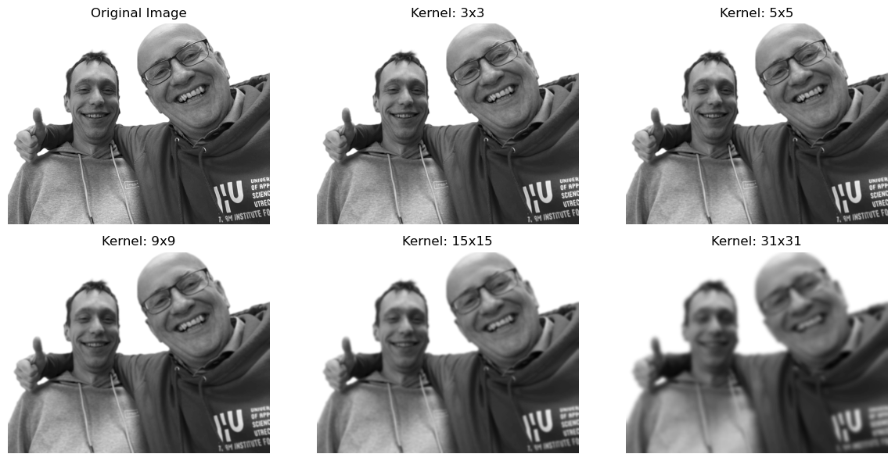
Gaussian
Notes:
How many 2nd derivative filters are there? There are four 2nd partial derivative filters.
In practice, it’s handy to define a single 2nd derivative filter—the Laplacian

Slide 35
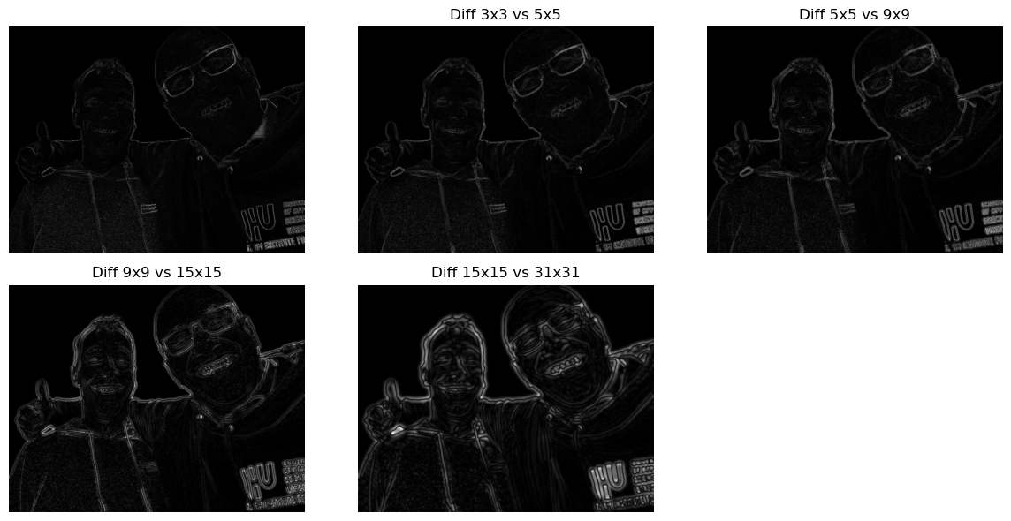
Gaussian
Notes:
How many 2nd derivative filters are there? There are four 2nd partial derivative filters.
In practice, it’s handy to define a single 2nd derivative filter—the Laplacian

Slide 36
Gaussian
Notes:
How many 2nd derivative filters are there? There are four 2nd partial derivative filters.
In practice, it’s handy to define a single 2nd derivative filter—the Laplacian

Slide 37
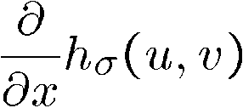
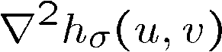
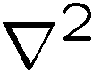
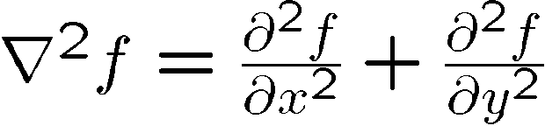
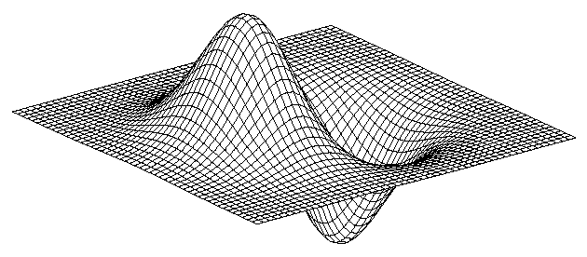
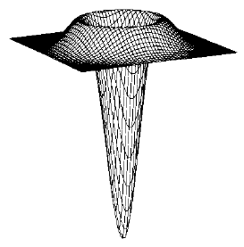
Gaussian
Laplacian of Gaussian
derivative of Gaussian
is the Laplacian operator:
Notes:
How many 2nd derivative filters are there? There are four 2nd partial derivative filters.
In practice, it’s handy to define a single 2nd derivative filter—the Laplacian

Slide 38
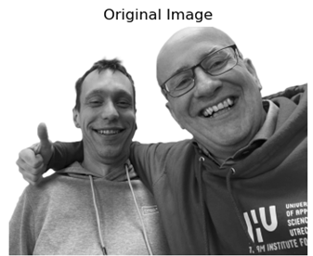
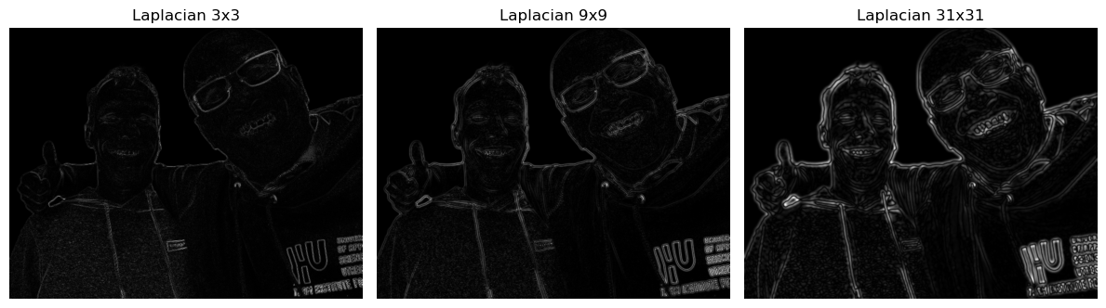
Laplacian of Gaussian
Notes:
How many 2nd derivative filters are there? There are four 2nd partial derivative filters.
In practice, it’s handy to define a single 2nd derivative filter—the Laplacian

Slide 40
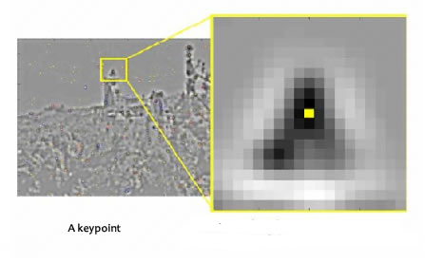
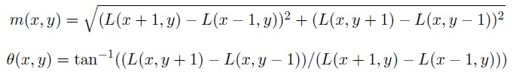
Keypoint beschrijving (1)
Voor alle pixels rondom het keypoint worden de grootte en richting van het intensiteitsverloop berekend:

Slide 41
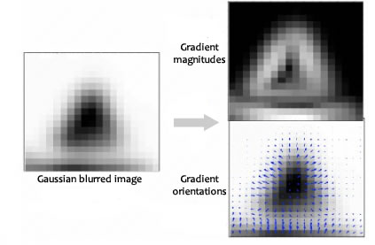
Keypoint beschrijving (2)
Richtingen (θ) worden opgedeeld in 36 histogram bin’s;
0 – 9°, 10 – 19°, etc.;
Aan de bin wordt een waarde toegevoegd overeenkomend met de grootte (m) van het intensiteitsverloop;

Slide 42
Keypoint beschrijving (3) Resultaat

Slide 43

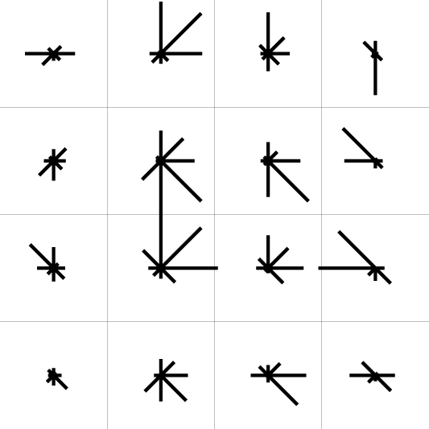
Keypoint beschrijving (4)
Gebruik histogrammen om sub-patches rondom het keypoint te ordenen op basis van oriëntaties:
0
2
π
https://www.cs.ubc.ca/~lowe/keypoints/

Slide 44
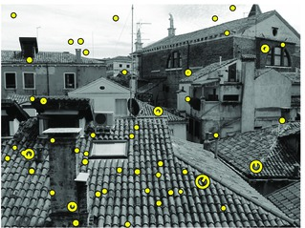
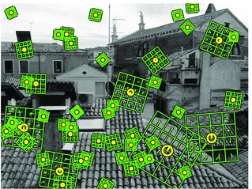
SIFT met de descriptors

Slide 45


Challenge: waar zijn we?

Slide 46


NASA Mars Rover images with SIFT feature matches
Figure by Noah Snavely

Slide 47

Keypoint matching t.b.v. stitching

Slide 48

Keypoint matching t.b.v. stitching

Slide 49



Slide 50





$$⊗$$
https://debuggercafe.com/template-matching-with-opencv/

Slide 51

Break?

Slide 52
Content
Convolution
Theory
1D
signal -> frequency
2D
Applications
canny edge / optical flow/ shift / cnn / template matching*
...

Slide 53
Content
Convolution
Theory
1D
signal -> frequency
2D
Applications
canny edge / optical flow/ shift / cnn / template matching*
Color space
RGB, HSV
Hough transform
Shape detection
Other...

Slide 54




Color space
CMYK (voor druk/print)
HSV
H- kleur
S - hoeveel
V - hoe donker
RGB red, green, blue

Slide 55


Slide 56


Slide 57





1st row
2nd row
GRAY
3^{td} row
RGB
HSV

Slide 58

Hough transform
Hough lines
Hough circles
Gray
Gaussian blur
Canny Edge
Hough Lines

Slide 59


https://medium.com/@tomasz.kacmajor/hough-lines-transform-explained-645feda072ab
$$\text{ρ}\text{ = }\text{x} \text{cos}\text{(}θ\text{) + }\text{y} \text{sin}\text{(}θ\text{)}$$
$$\text{ρ}\text{ = }y \text{sin}\text{(}θ\text{)}\text{ (}\text{voor} \text{x}\text{=0)}$$
$$\text{ρ}\text{ = }x \text{cos}\text{(}θ\text{)}\text{ (}\text{voor} \text{y}\text{=0)}$$

Slide 60



Slide 61


Slide 62


Slide 63


Binary threshold

Slide 64


Slide 65


Hough Circles

Slide 66


Shape detection
https://pyimagesearch.com/2016/02/01/opencv-center-of-contour/
https://pyimagesearch.com/2016/02/08/opencv-shape-detection/

Slide 67
Other...
https://docs.opencv.org/4.x/javadoc/index-all.html
import cv2
functions = dir(cv2)
for func in functions:
print(func)
import inspect
functions = [func for func in dir(cv2) if inspect.isbuiltin(getattr(cv2, func, None))]
print(functions)

Slide 68

Thank you for your attention!
Questions?

